Slide 1
Android UI Elements
J M Githeko
May 2017

Slide 2
Agenda
INTRODUCTION
XML UI files
XML resource files
Layouts
UI Widgets

Slide 3
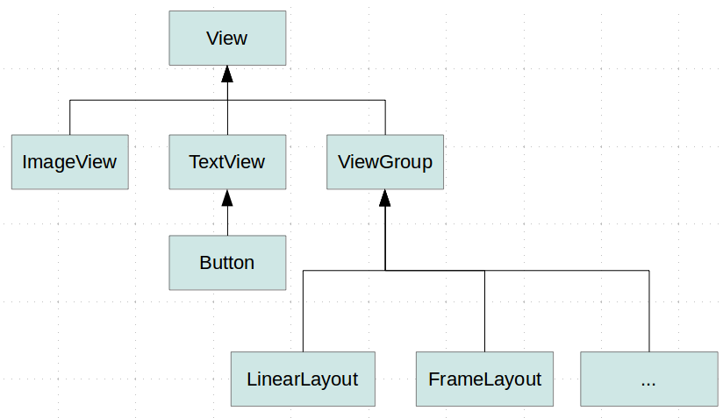
Introduction to Android UI
All Android UI objects are part of subclasses of the View class including ViewGroup. The View can be conceptualized as a tree structure with branches and leave nodes in which the View class is the root node.
The diagram in this slide and the next help show this structure

Slide 4
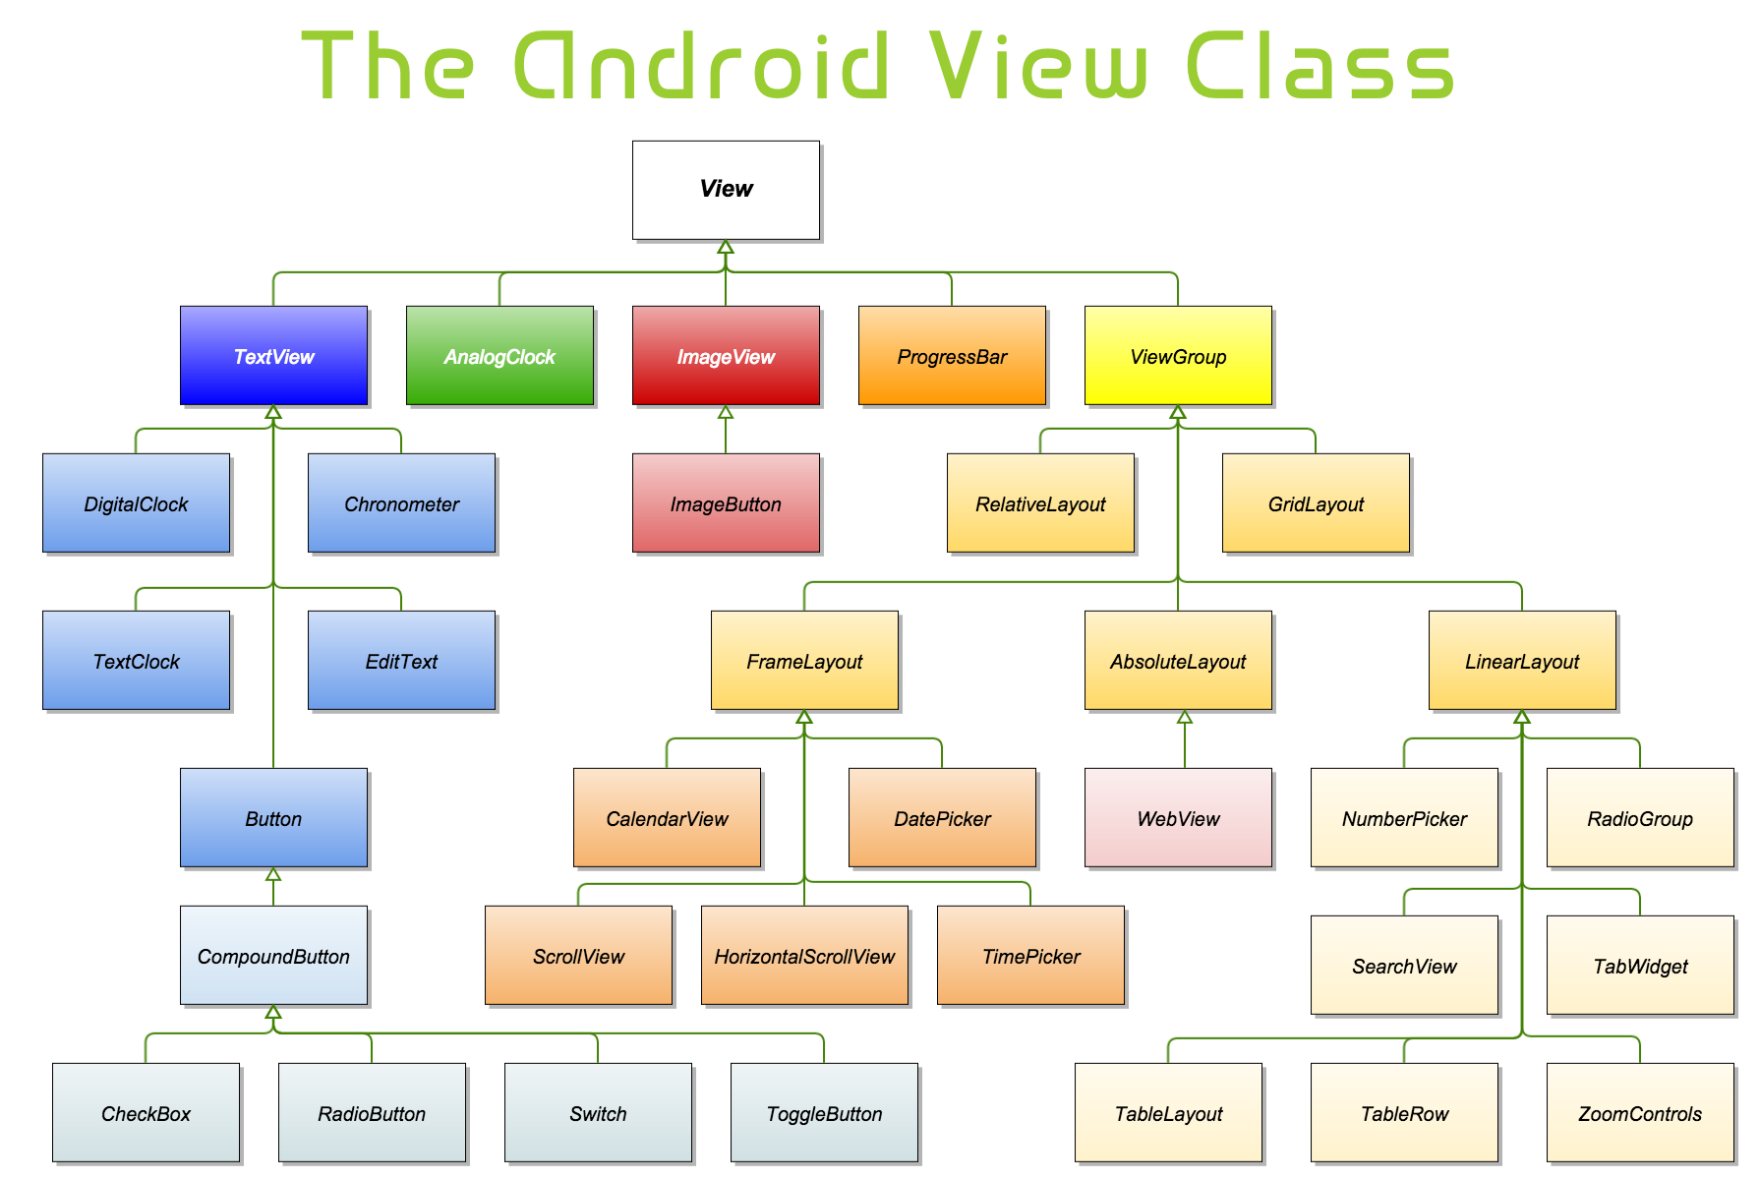

Slide 5
XML UI Files
User interface definitions can be implemented using Java code but more often, they the UI is designed using XML files. Each Android Activity and Fragment is normally associated with an XML file.
This file typically consists of:
XML version and character set specification
Layout specification
UI Widgets
An example is shown in the next slide

Slide 6
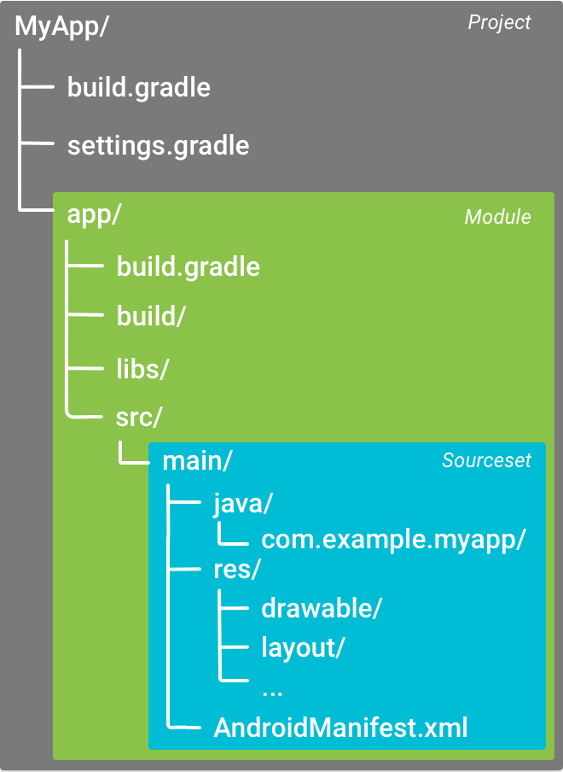
Android Project File Organization

Slide 7
XML File Sample
<?xml version="1.0" encoding="utf-8"?>
<LinearLayout xmlns:android="http://schemas.android.com/apk/res/android"
android:layout_width="fill_parent"
android:layout_height="fill_parent"
android:orientation="vertical" >
<TextView android:id="@+id/text"
android:layout_width="wrap_content"
android:layout_height="wrap_content"
android:text="This is a TextView" />
<Button android:id="@+id/button"
android:layout_width="wrap_content"
android:layout_height="wrap_content"
android:text="This is a Button" />
<!-- More GUI components go here -->
</LinearLayout>
XML layout
XML Schema for Android UI files
Widgets
Layout closing tag

Slide 8
XML UI Files
The XML user interface files define that layouts in which the UI widgets are to be placed.
Common layouts are listed in the next slide
The files are named with a file extension “xml” such as “activity_main.xml”
XML layout files are located in the res/layout project folder

Slide 9
Android Layouts
Linear Layout: LinearLayout is a view group that aligns all children in a single direction, vertically or horizontally.
Relative Layout: RelativeLayout is a view group that displays child views in relative positions.
Table Layout: TableLayout is a view that groups views into TableRows and columns.
Absolute Layout: AbsoluteLayout enables you to specify the exact location of its children.
Frame Layout: The FrameLayout is a placeholder on screen that you can use to display a single view.
List View: ListView is a view group that displays a list of scrollable items.
Grid View: GridView is a ViewGroup that displays items in a two-dimensional, scrollable grid.

Slide 10
FrameLayout
FrameLayout allows elements within it (call child elements) to be layered one over the other and to be either visible or not visible.
The visibility of child elements can be controlled programmatically in the code or less flexibly via XML gravity settings and shown in the examples that follow

Slide 11
Sample FrameLayout code (details removed)
<FrameLayout
xmlns:android="http://schemas.android.com/apk/res/android"
android:id="@+id/frame_layout"
android:layout_width="match_parent" android:layout_height="match_parent" >
<!-- Child1 is drawn first .... Child2 is drawn over Child1....Child3 is drawn over Child1 and Child2 -->
<TextView
android:id="@+id/child1"
android:layout_width="wrap_content" android:layout_height="wrap_content"
android:layout_gravity="bottom|right" />
<ImageView
android:id="@+id/child2"
android:layout_width="match_parent" android:layout_height="match_parent"
android:layout_gravity="center" />
<ImageView
android:id="@+id/child3"
android:layout_width="match_parent" android:layout_height="match_parent"
android:contentDescription="Image"
android:src="@color/_dark_gray" />
</FrameLayout >

Slide 12
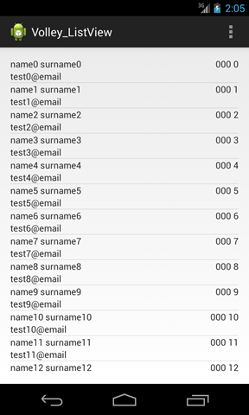
ListView example
Items are arranged in a vertical list and can scroll up and down if the number of items is more than can fit on one screenful
ListViews are widgets and not real layouts but serve the same purpose as layouts
<ListView
android:id="@+id/mobile_list"
android:layout_width="match_parent"
android:layout_height="wrap_content" >
</ListView>

Slide 13
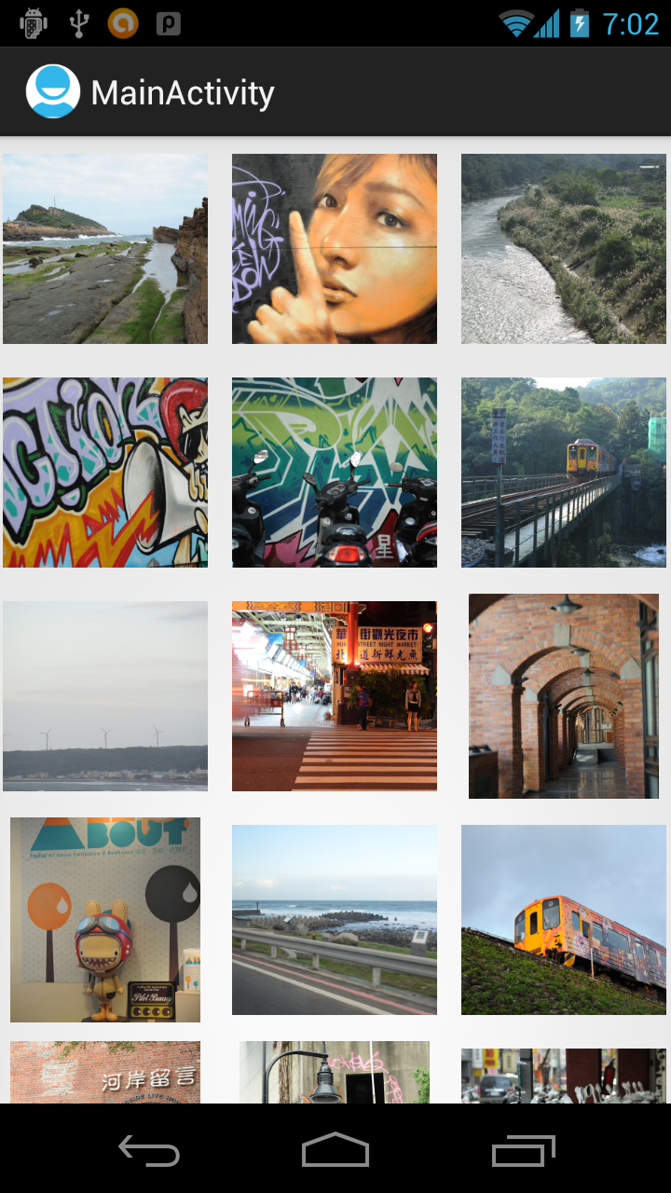
GridView Example http://android-er.blogspot.co.ke/2012/07/apply-lrucache-on-gridview.html
Items are arranged in a 2-dimentional grid and can scroll up and down if the number of items is more than can fit on one screenful
GridViews are widgets and not real layouts

Slide 14
Cont’d
<?xml version="1.0" encoding="utf-8"?>
<GridView xmlns:android="http://schemas.android.com/apk/res/android"
android:id="@+id/gridview"
android:layout_width="fill_parent"
android:layout_height="fill_parent"
android:columnWidth="90dp"
android:numColumns="auto_fit"
android:verticalSpacing="10dp"
android:horizontalSpacing="10dp"
android:stretchMode="columnWidth"
android:gravity="center"
/>

Slide 15
Java
package com.example.helloworld;
import android.os.Bundle;
import android.app.Activity;
import android.view.Menu;
import android.widget.GridView;
public class MainActivity extends Activity {
@Override
protected void onCreate(Bundle savedInstanceState) {
super.onCreate(savedInstanceState);
setContentView(R.layout.activity_main);
GridView gridview = (GridView) findViewById(R.id.gridview);
gridview.setAdapter(new ImageAdapter(this));
}
}

Slide 16
Cont’d
ListView and GridLayout and some other layouts require an Adapter.
See this tutorial for an example:
https://www.tutorialspoint.com/android/android_grid_view.htm

Slide 17
TableLayout
<TableLayout>
<TableRow> </TableRow>
<TableRow> </TableRow>
<TableRow> <button /> <button /> </TableRow>
</ TableLayout >
See this example: https://www.mkyong.com/android/android-tablelayout-example/

Slide 18
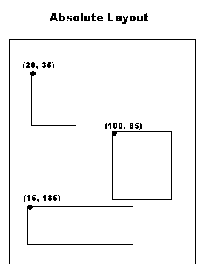
AbsoluteLayouts
An Absolute Layout lets you specify exact locations (x/y coordinates) of its children.
Absolute layouts are less flexible and harder to maintain than other types of layouts without absolute positioning
See tutorial:
https://www.tutorialspoint.com/android/android_absolute_layout.htm

Slide 19
The End
Next week:
Handler examples
Adapter examples (ListView, GridView)
Testing/Debugging
Later
Styles and Themes
Release process
Examples apps – Mapping, database…

